Slide 1

Project -
Inspired by TRUE events

Slide 2
Student Connect
Chinenye (Sophia) Nwankwo
Xin (Echo) Ma
Jayendra Khandare
Juyoung (Jane) An
Lydia Creech
Subramanian (Subbu) Shanmugavel

Slide 3
Index
No. | Topic | Covered by
1 | Introduction | Subbu
2 | Objectives
3 | Motivation for the project
4 | Interviews and Surveys | Lydia
5 | Models & Diagrams
6 | Wireframes | Xin
7 | The Conclusion

Slide 4

Objectives | Create an applet on the "one.iu.edu" by gathering all information needed by students at a single place which will be accessible to every student of IU to make student feel more connected and they don't feel left out.
Project Overview | •Overcoming the difficulty to utilize the resources available to students as resources are scattered. •Grouping and organizing all of the resources available in one place to help international students. •Connecting students with similar profile based on their hobbies, interests, learnings, place of origin, cultural aspects, sports interest and further more. •Helping international students with the logistics of bureaucratic procedures.

Slide 5
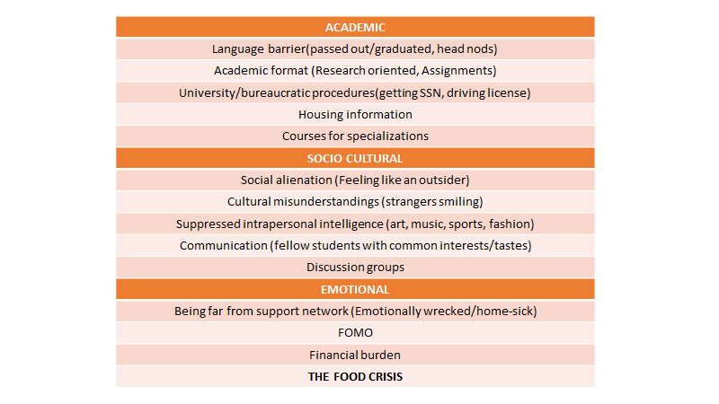
Motivation
They are literally too much to deal with.

Slide 6

Planning
Planning
Project Identification & Selection
Organizational Mission, Objectives, and Strategy
Organization Mission Statement
Bloomington is the flagship residential, doctoral-extensive campus of Indiana University.
Its mission is to create, disseminate, preserve, and apply knowledge.
Statement of Objectives
commitments to cutting-edge research, scholarship, arts, and creative activity
commitments to challenging and inspired undergraduate, graduate, professional, and lifelong education
commitments to culturally diverse and international educational programs and communities
commitments to first-rate library and museum collections
commitments to economic development in the state and region
commitments to meaningful experiences outside the classroom

Slide 7
Planning
Planning
Project Identification & Selection
Academics | 111 | HR & Benefits | 26
Accounts | 29 | International | 19
Administrative | 211 | IT Services | 78
Admissions | 15 | Libraries | 13
Campus Life | 50 | Orientation | 19
Careers | 20 | Payroll & Taxes | 19
Enrollment | 35 | Personal Information | 16
Faculty Services | 56 | Research | 109
Finances | 61 | Training | 37
Housing & Dining | 34 | Transportation | 20
Analysis of existing System
*Constraints on IS Development
- Dizzy interface
- Categorized based on
Most Popular/ Highest Rated
- 623 applications in Bloomington campus
Notes:
Organizational mission and objectives are introduced before and
Information Inventory provides a summary of the various business processes, functions, data entities, and information needs of the enterprise. The inventory will view both current and future needs.

Slide 8
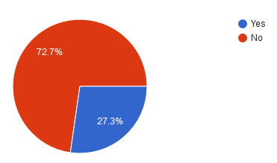
Planning
Planning
Planning
Survey
Academic
When deciding on courses to take for your degree, you might have had some help from seniors or professors. Is it possible to get that kind of help through One.iu?

Slide 9
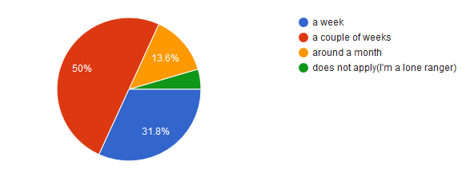
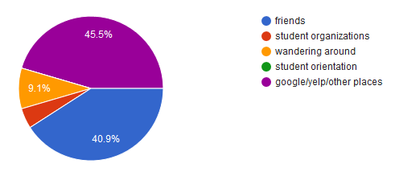
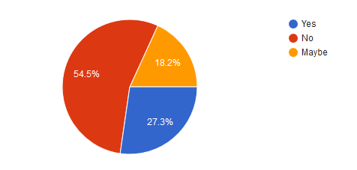
Planning
Planning
Planning
Planning
Socio-cultural - Questions about ease of finding new friends, information about the community, finding food!
Notes:
How long it took to make acquaintances w/ other students? Information about Bloomington community? RIGHT: Finding food, important because REQUIRES A NETWORK

Slide 10
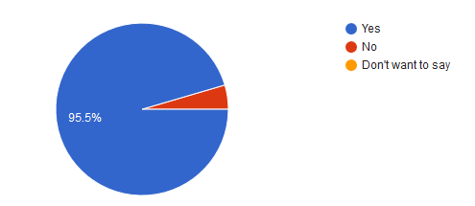
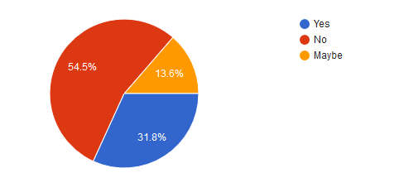
Planning
Living - questions dealing with whether One.iu.edu was helpful for navigating difficulties getting necessary documemntation, such as SSN or driver’s licenses.
etc
Notes:
Using One.iu.edu for help getting lisneces, SSN, ect.

Slide 11
Outcomes of the survey
Students prefer the environment and niceties of people in America, but feel awkward initially.
Almost everybody has some extra-curricular interests, but they are not catered properly.
Academic format is not explained properly.
Most of the SOIC students don’t even know till this date(i.e. around 10 months) that they have access to Linux systems like Shark, the Hulk, Odin, etc.
Cultural barriers should be transformed into a fan-tong (that means useless in Chinese)

Slide 12
Interview Summary
Information is frontloaded
Introvert students will be overwhelmed, will be missed during Orientation
There are many resources, but they are not all in same location (such as One.iu.edu)

Slide 13
Real Interview Summary
Indian Student Association don’t really check their e-mails.
Everybody is trying to help in some way or the other.
By the number of students who actually show up for BWF events, we can say Indian and other international students are interested in knowing the traditions and festivals of America.

Slide 14
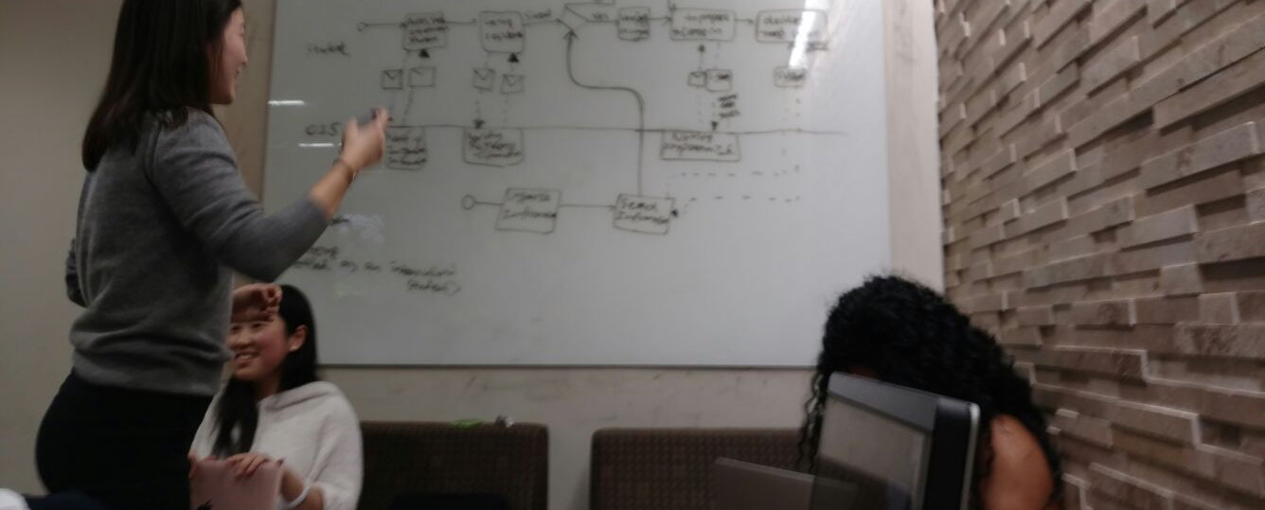
Rough Draft

Slide 15
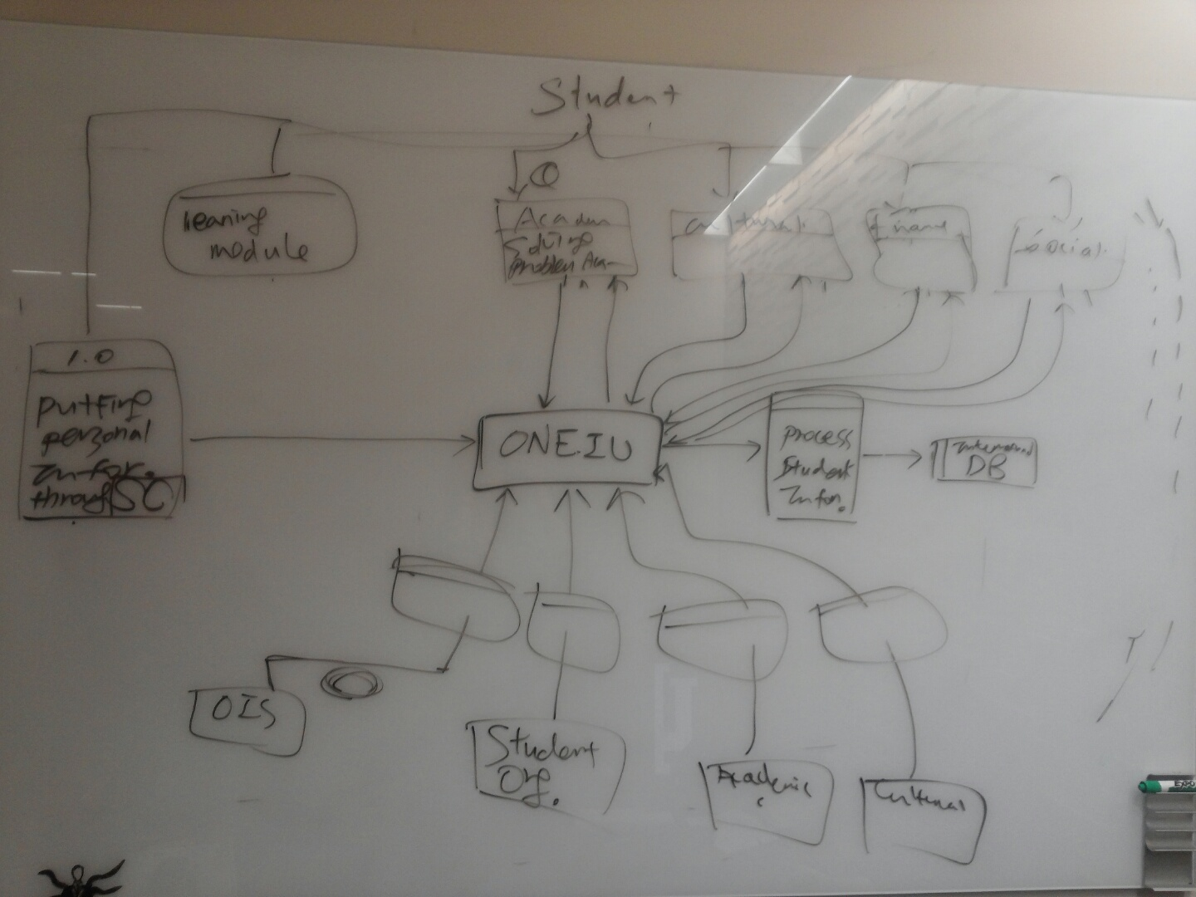
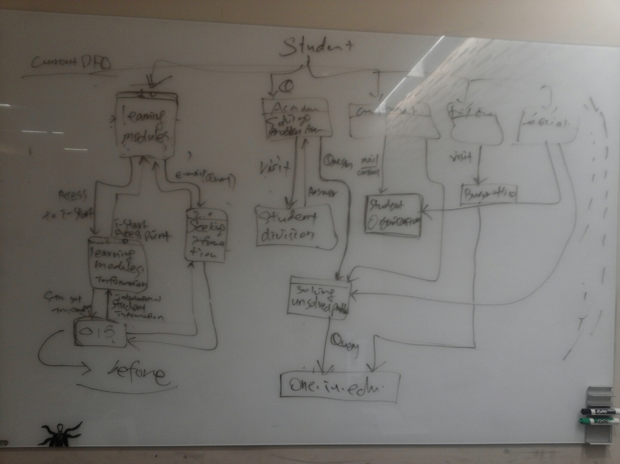
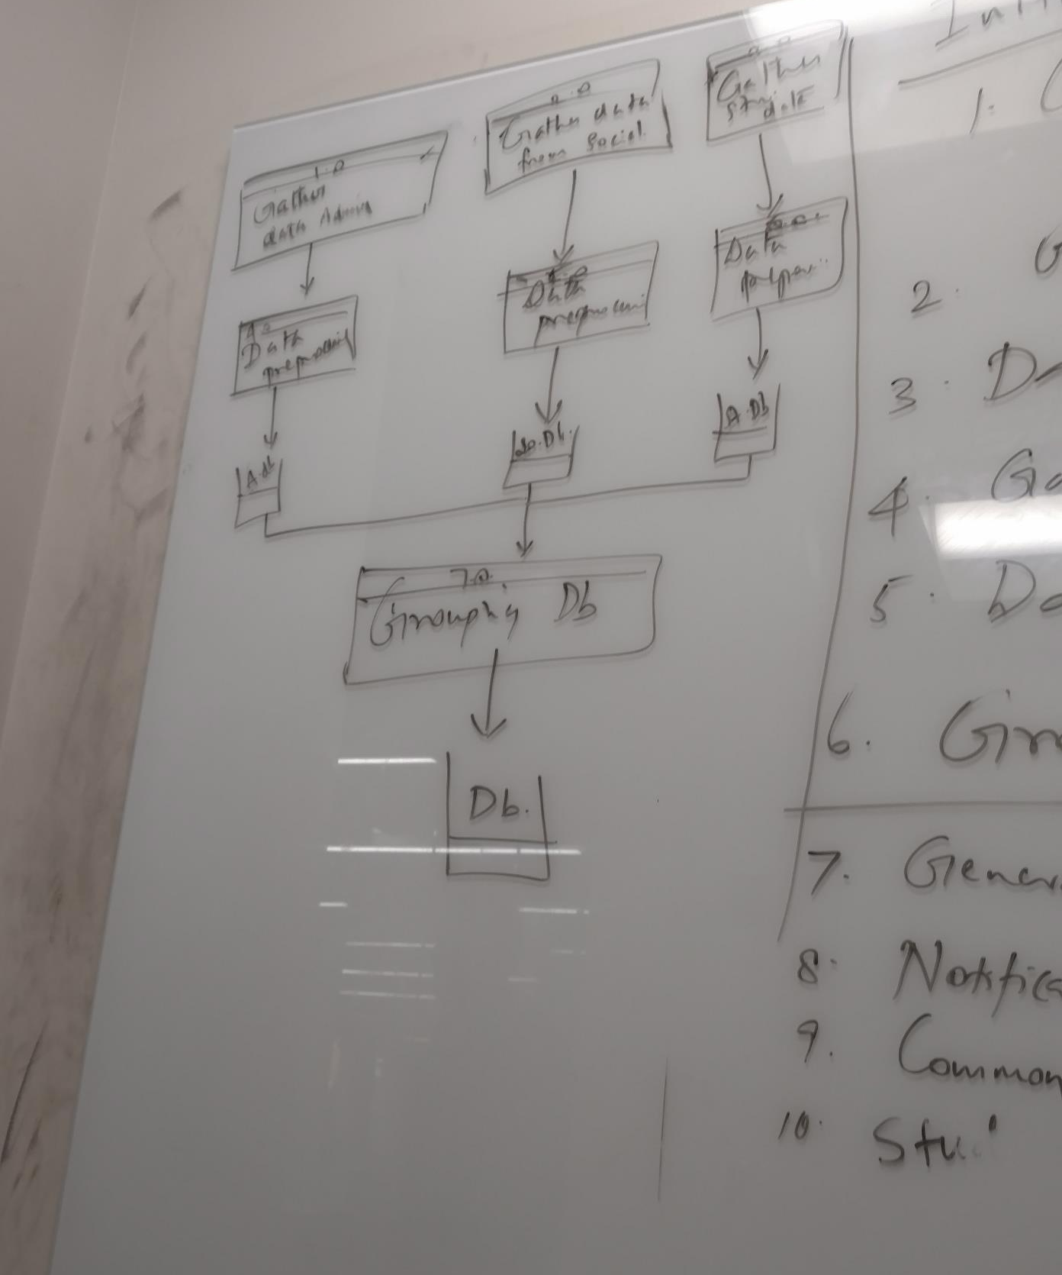
Rough Drafts (continued)

Slide 16
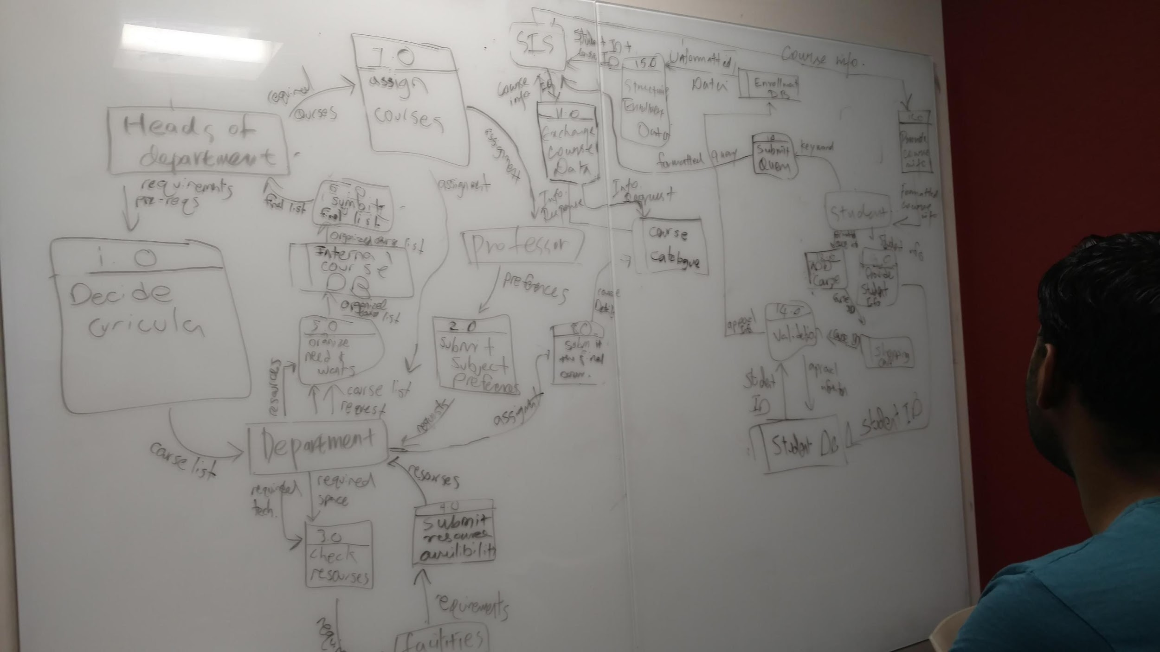
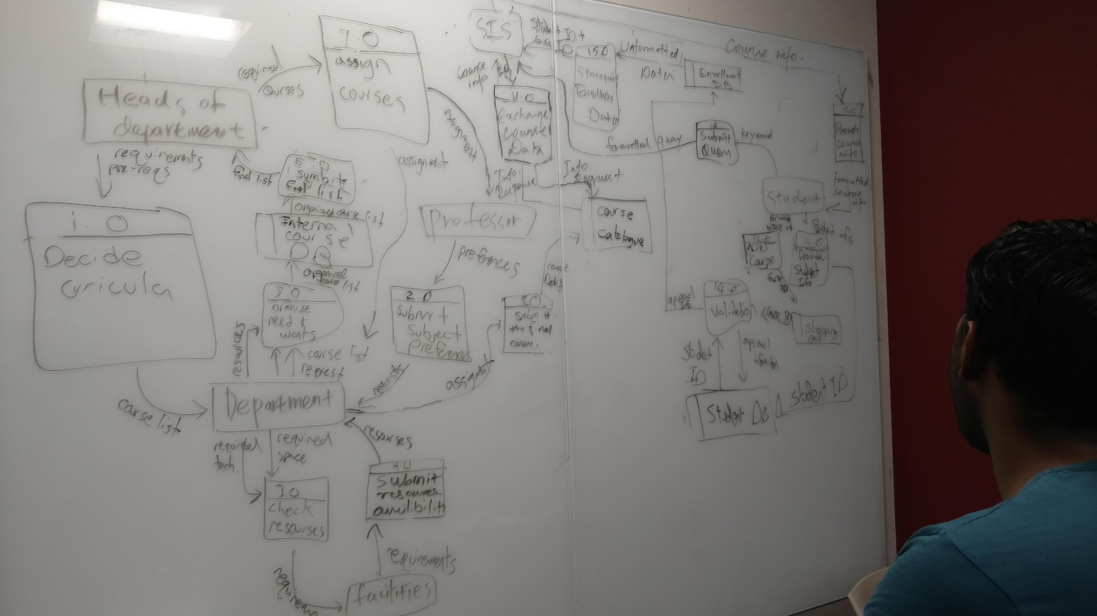
Rough Draft …(Seriously)

Slide 17
Planning Methodology Used
Initially we thought about going on with the standard Waterfall model.
At each meeting, we used to come up with new ideas to introduce.
So, we shifted to iterative model.
As we are dealing with planning and analysis only, this approach proved to be useful since we could add more and more features as we come across problems on the go.

Slide 18
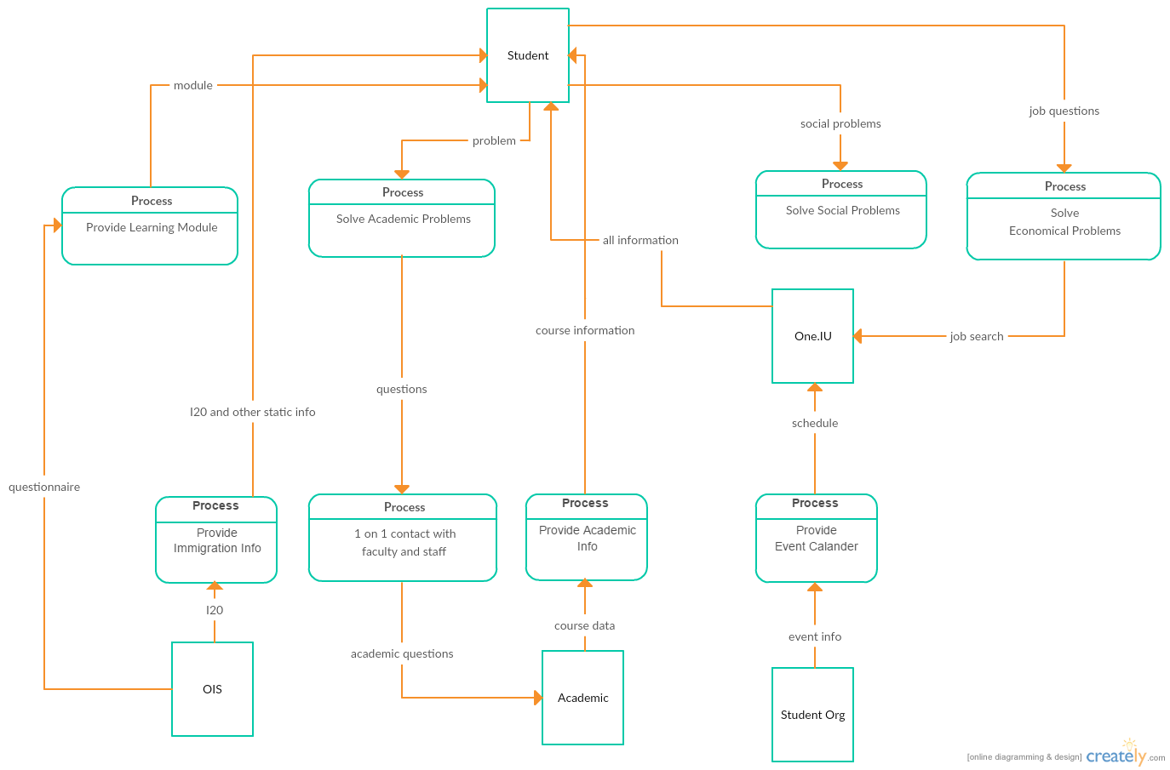
DFD NOW

Slide 19
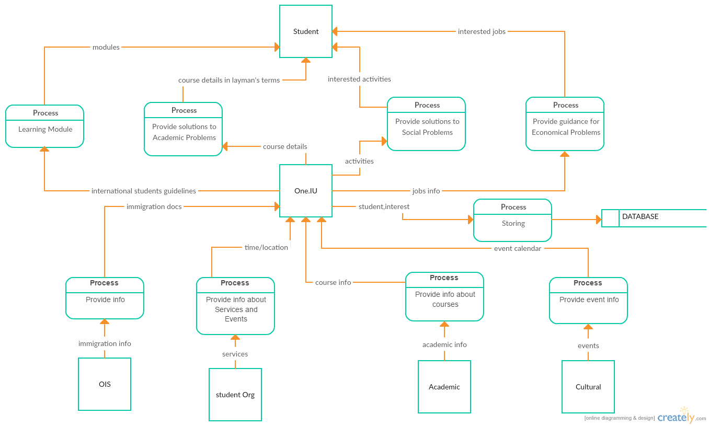
Proposed DFD (simple)

Slide 20
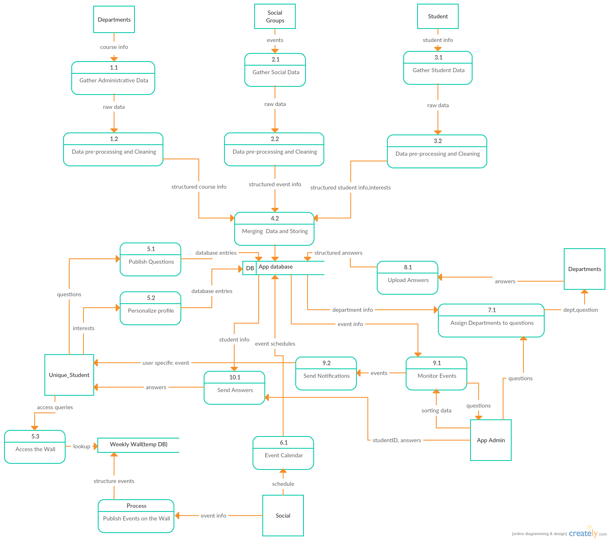
Proposed DFD (detailed)

Slide 21
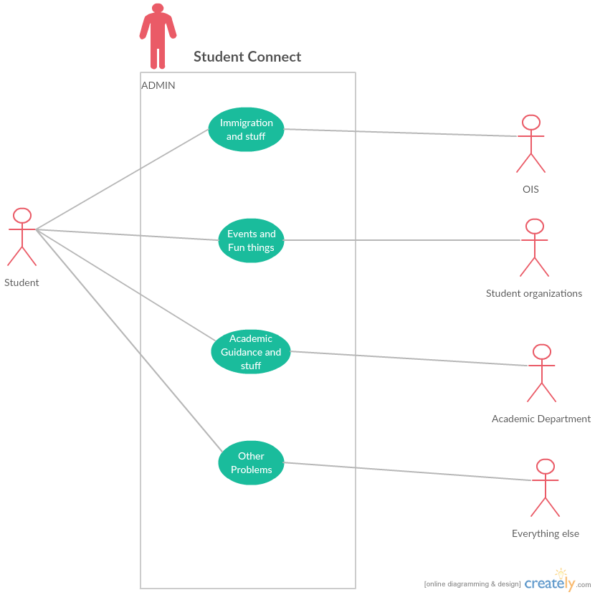
Use Case Diagram

Slide 22
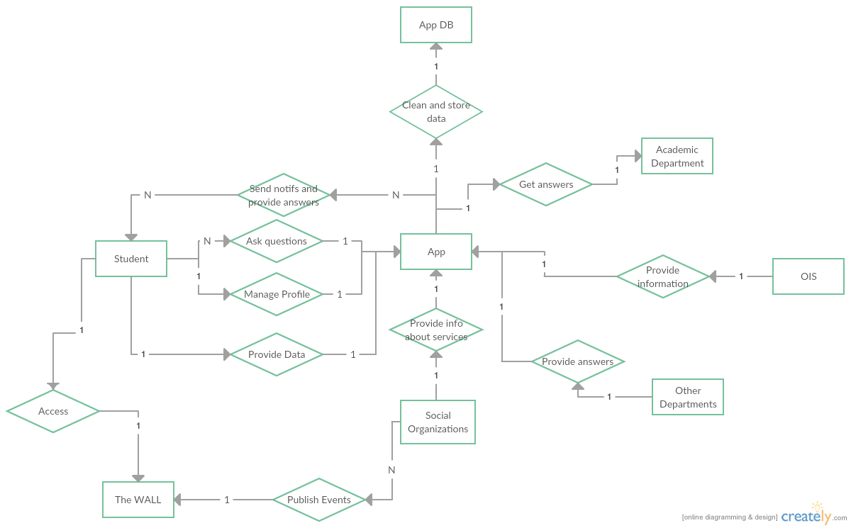
ER Diagram
Notes:
Chain diagram

Slide 23
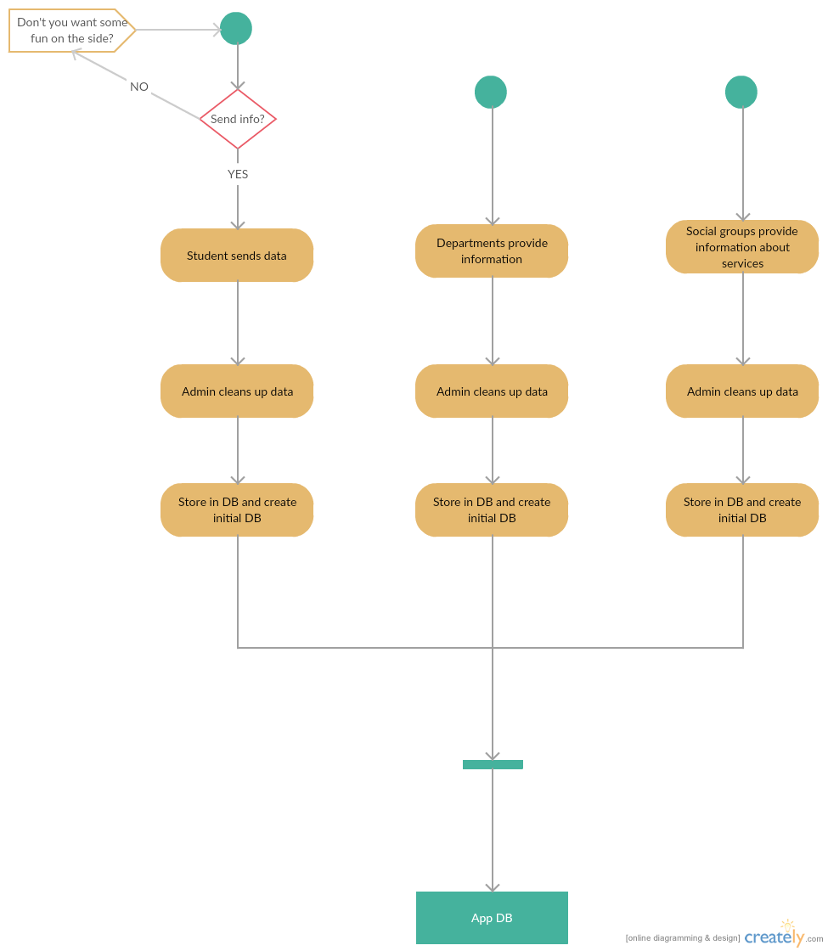
Student
DEPT
Social groups
Activity
Diagram for DB creation

Slide 24
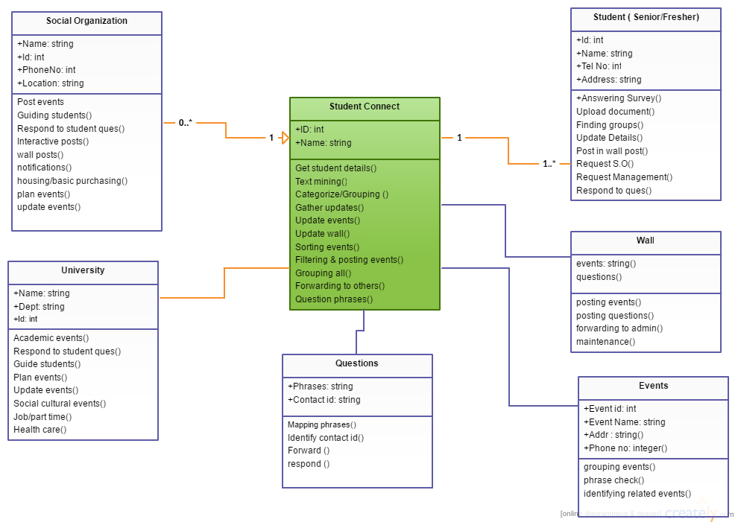
Class Diagram

Slide 25
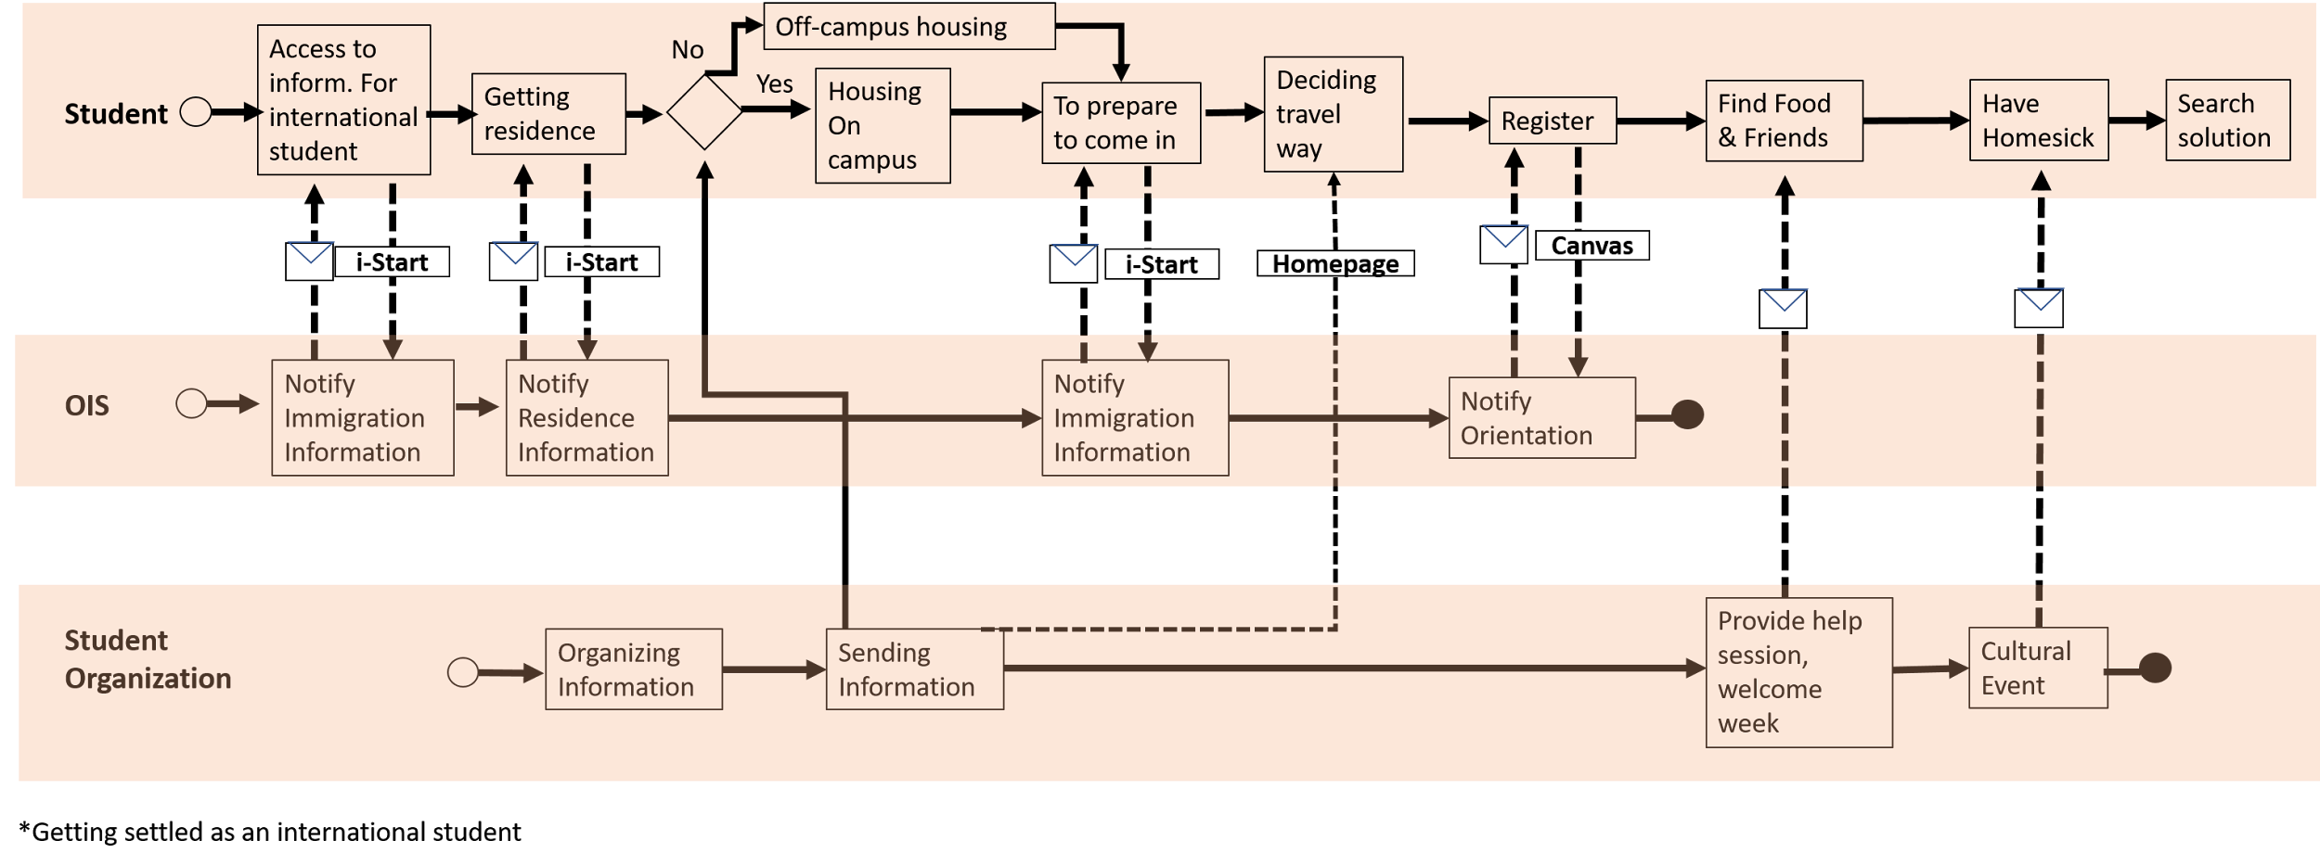
BPMN-Now

Slide 26
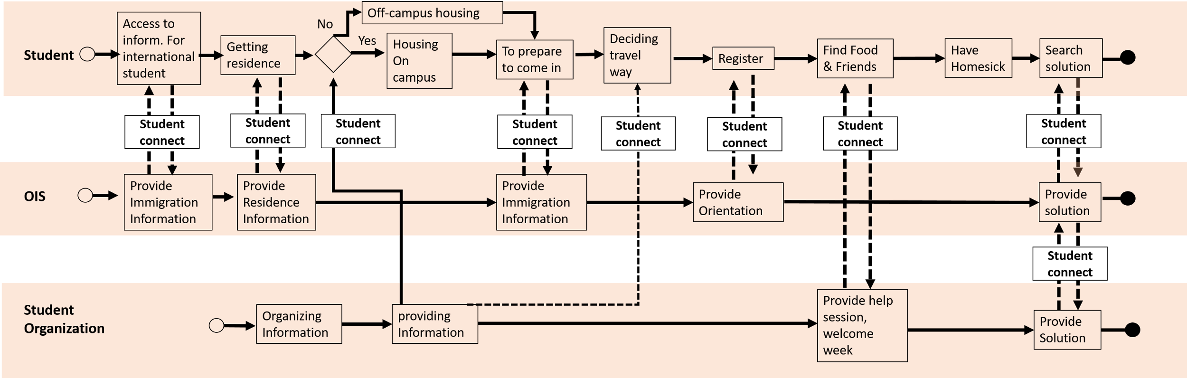
BPMN - after Student Connect

Slide 27
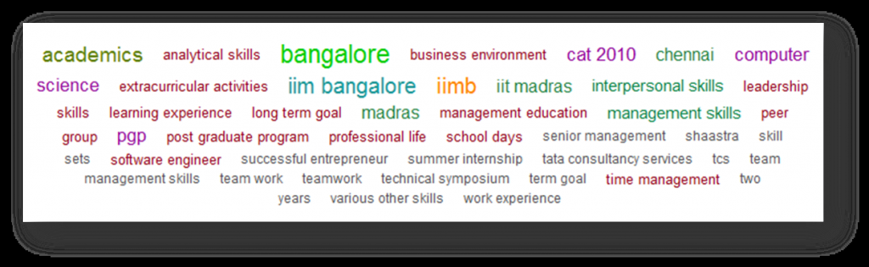
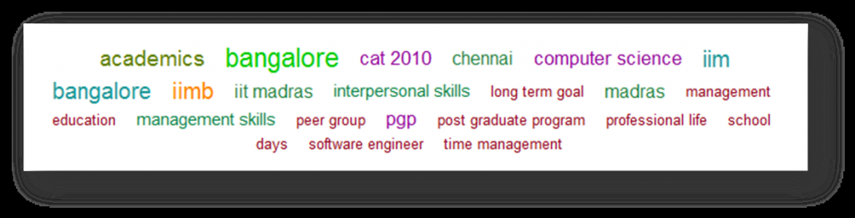
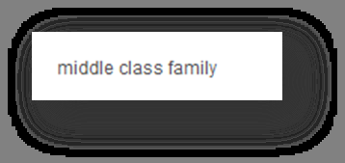
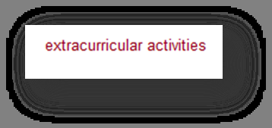
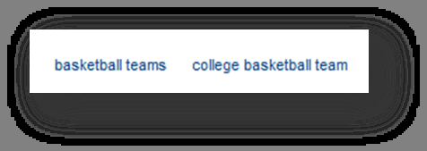
Text Mining in SOP (Statement of Purpose)

Slide 28
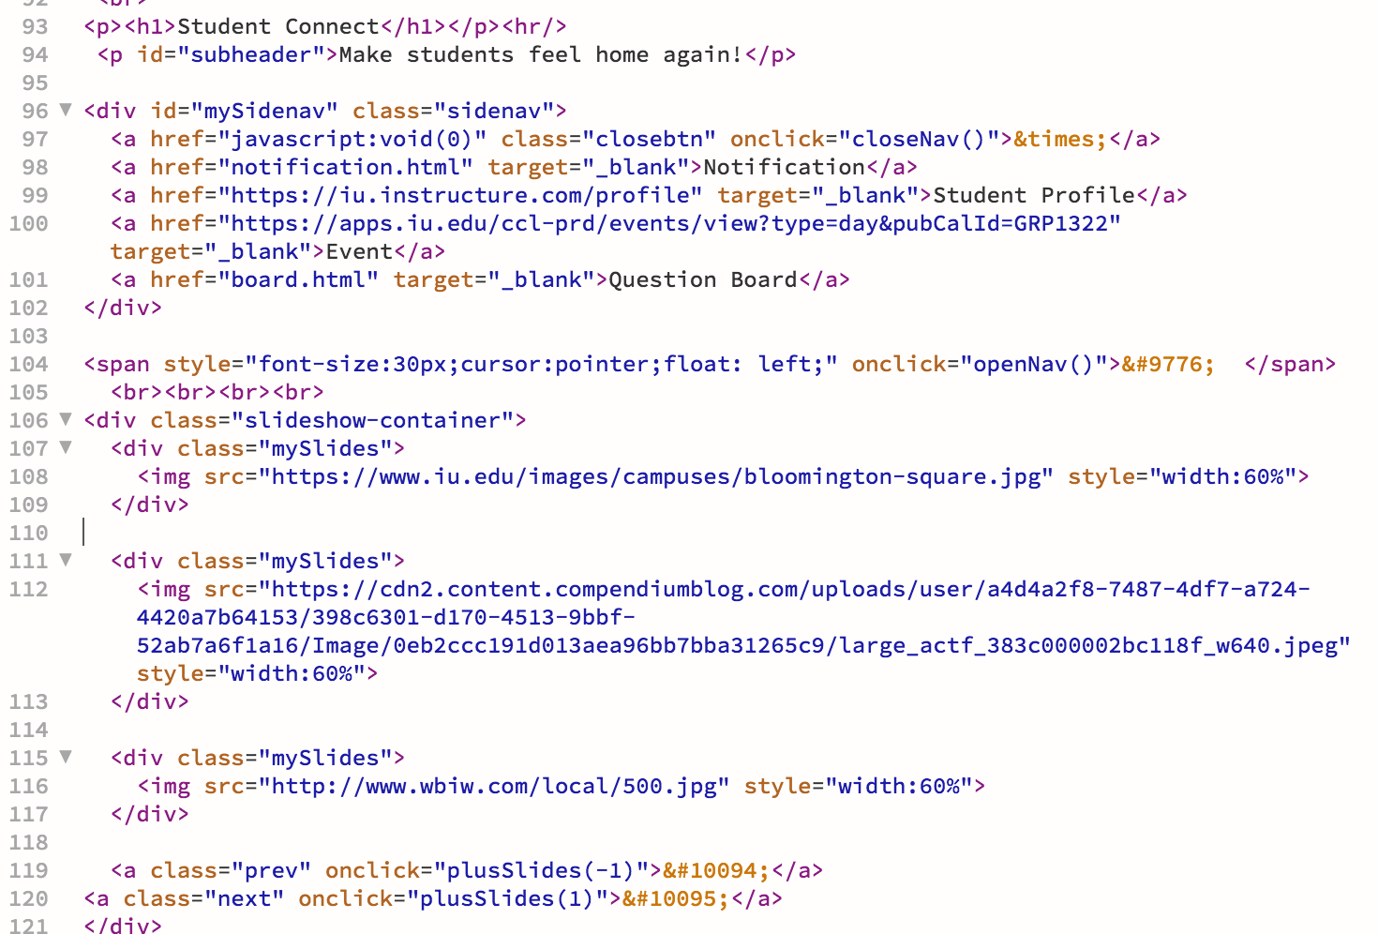
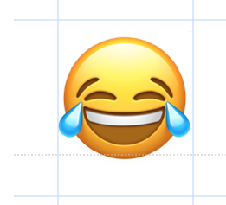
Wireframes
http://ella.ils.indiana.edu/~xinma/556/556.html
Website layout
It’s not hard, but takes up a lot of time.

Slide 29
Outcome
•Students will feel more connected.
•All the information needed by students will be at a single place.
•Students will get to know what Indiana University/social organization has to offer.
•Students with peculiar interests won’t feel left out.

Slide 30
Problems faced during meetings
Subbu can’t remember Xin and talks to other girls thinking they are her.
It’s pronounced Shin, Jay always calls her Zin.
Thrown out of East tower a few of times due to weird and loud laughing noises.( I wonder who it was?)
Discussions go out of scope (e.g. movies, food, cultural differences, Grudge ghost child) except for the Korean ‘kanya’ Juyoung who is steadfast with her book.
Sophia still can’t wrap her head around difference between South and North Korea.
We had no idea about how to propose an app for One.IU. For that, UITS was not that helpful.

Slide 31
Tools used so far
We used a lot of tools for various tasks …literally.
To name a few :
Canvas Group thing which included collaborations and all
Creately.com – for creating the final diagrams
Google Documents
Google Forms – for survey
CIAmedia (voice recorder app)
AUIProject – for Gantt charts
Microsoft Office(you can’t replace this)
Dreamweaver- for website

Slide 32
What we got to learn as a team
We should be able to use special abilities of everybody in the team.
We should consider everybody’s opinion.
There should be congruence in the team.
Online tools are effective for group projects since everybody can contribute anytime they are comfortable with.
All the good ideas(which were missing till the end) appear out of nowhere at the very last moment.
Somebody might lose his cool eventually.

Slide 33
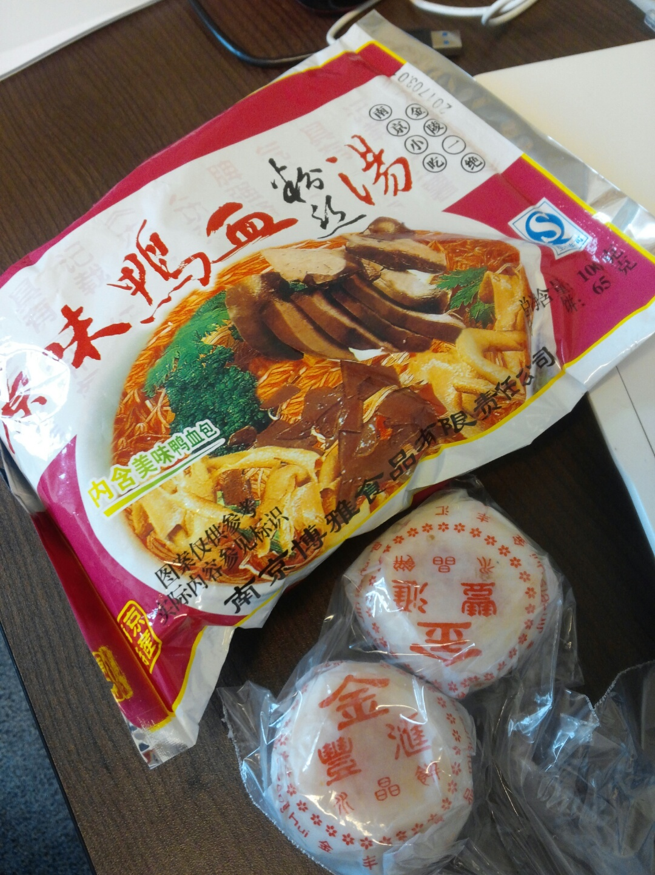
What we “actually” got to learn
How to plan a project (duh).
The taste of Korean food.
The awesomeness of Indian food.
The taste of dreaded Chinese ‘Duck Blood’ thing(it is exactly what the title says).
Got to witness transformation of Sophia’s hairstyle.
Got to know that Korea is not a place for plus size people like Jay(who is more like +++++).

Slide 34
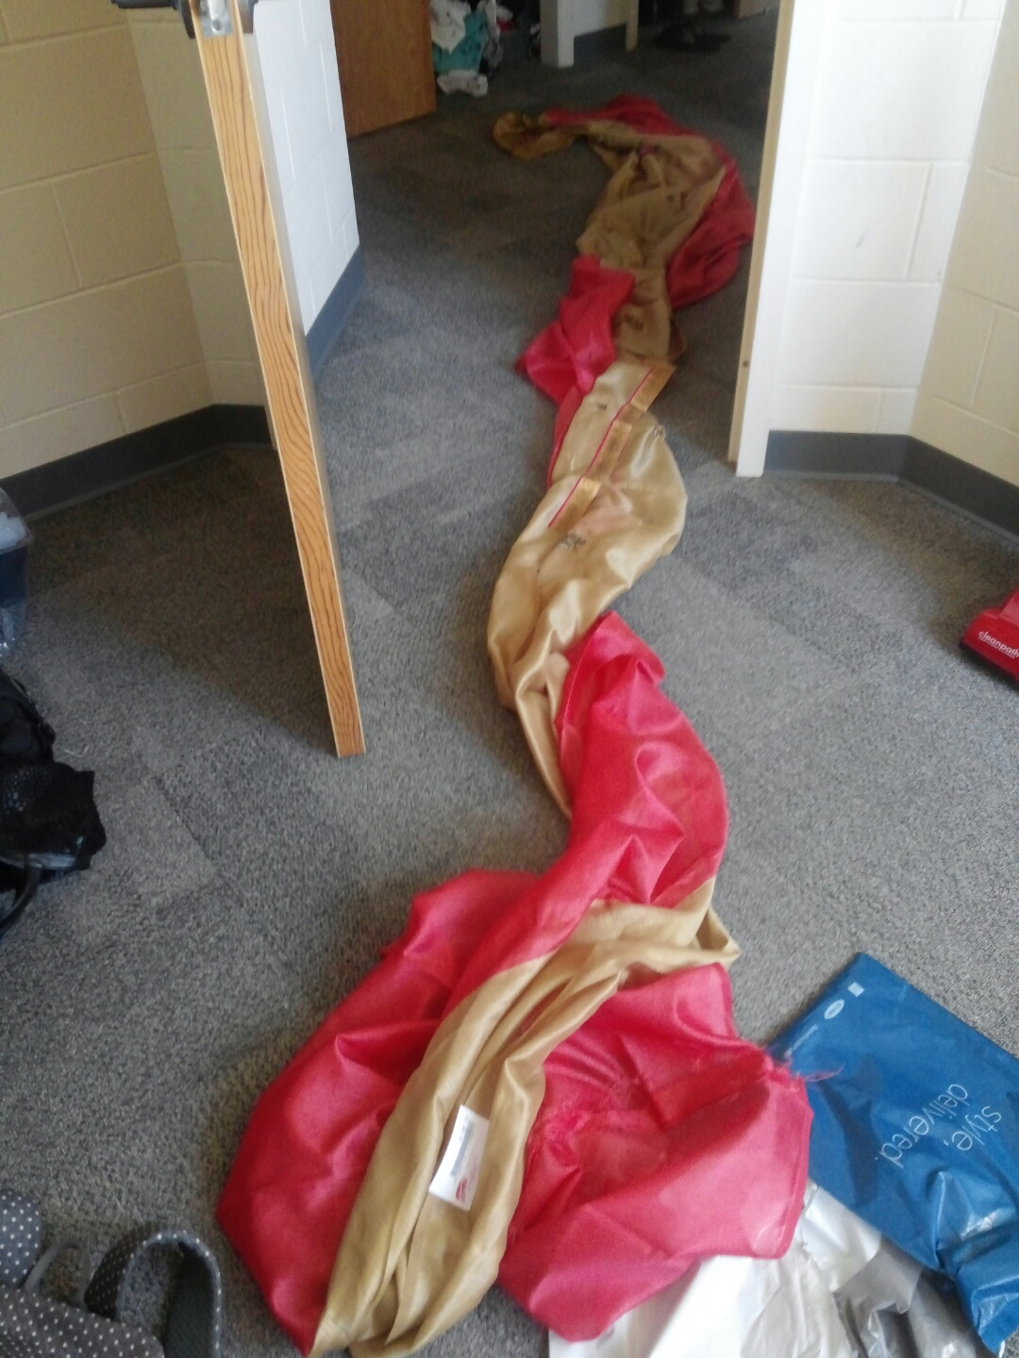
What we “actually” got to learn
How to wear a Saree (only Juyoung learned that).
North Korea is different from South Korea.
Saree is really loooong!!!

Slide 35
Thanks
*We would like to appreciate all our spies for all the secret information provided by them.
By the time you read this, Professor Carol might have asked all the questions.
If you guys still have some, you can ask them now.
It is always good to have a curious mind.

